Slide 1


IONIC PRESENTATION
Presented By – Mohuya Banerjee
Designation – Senior Developer

Slide 2
OVERVIEW:-
Introduction to Ionic.
Benefits of Ionic.
Ionic advantages.
Pre-requisites Softwares.
How to setup an Ionic App.
App Structure.
Deployment.

Slide 3
Introduction to IONIC
Ionic is an open source UI toolkit for building performant, high-quality mobile and desktop apps using web technologies — HTML, CSS, and JavaScript — with integrations for popular frameworks like Angular, React, and Vue.
Ionic 6 supports Angular 12+. Update to the latest version of Angular.
Ionic focuses on the frontend UX and UI interaction of an app — UI controls, interactions, gestures, animations. It's easy to learn, and integrates with other libraries or frameworks, such as Angular, React, or Vue. Alternatively, it can be used standalone without any frontend framework using a simple script include.
Ionic is the only mobile app stack that enables web developers to build apps for all major app stores and the mobile web from a single codebase. And with Adaptive Styling, Ionic apps look and feel at home on every device.

Slide 4
Benefits of Ionic
One codebase, running everywhere.
A focus on performance.
Clean, simple, and functional design.
Native and Web optimized.

Slide 5
Ionic advantages
Cross-platform
Build and deploy apps that work across multiple platforms, such as native iOS, Android, desktop, and the web as a Progressive Web App - all with one code base. Write once, run anywhere
Web Standards-based
Ionic is built on top of reliable, standardized web technologies: HTML, CSS, and JavaScript, using modern Web APIs such as Custom Elements and Shadow DOM. Because of this, Ionic components have a stable API, and aren't at the whim of a single platform vendor.
Beautiful Design
Clean, simple, and functional. Ionic is designed to work and display beautifully out-of-the-box across all platforms. Start with pre-designed components, typography, interactive paradigms, and a gorgeous (yet extensible) base theme.
Simplicity
Ionic is built with simplicity in mind, so that creating apps is enjoyable, easy to learn, and accessible to just about anyone with web development skills.

Slide 6
Ionic Setup
Pre-requisites Softwares:-
Node JS
Visual Studio Code
Chrome
Angular
Ionic

Slide 7
How to set-up an Ionic App
Before proceeding, make sure your computer has Node.js installed.
Installation Setup:-
Step 1:- Install Node.
Step 2:- Install Ionic CLI :- npm install -g @ionic/cli
Step 3:- Install Angular CLI :- npm install -g @angular/cli
Step 4:- Create ionic app with default template:- ionic start myApp blank or ionic start myApp blank –type=angular
Step 5:- Create App with Angular:- Step 6:- Go to your App:- cd myApp
Step 6:- Run the App:- ionic serve or ionic serve --lab

Slide 8
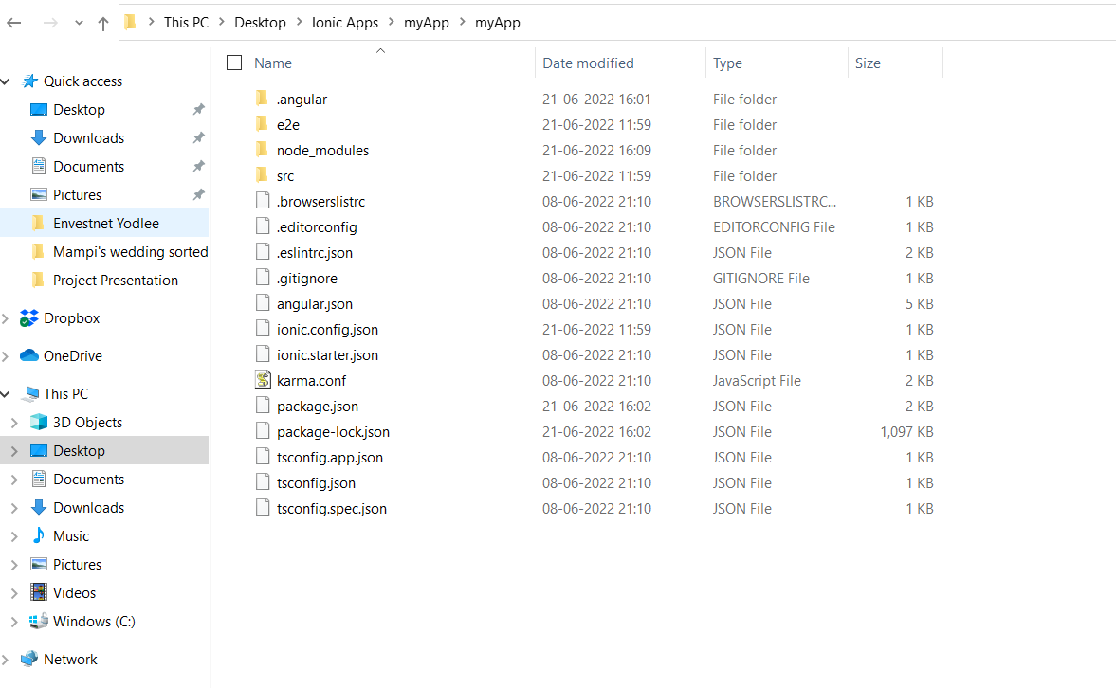
App Structure

Slide 9
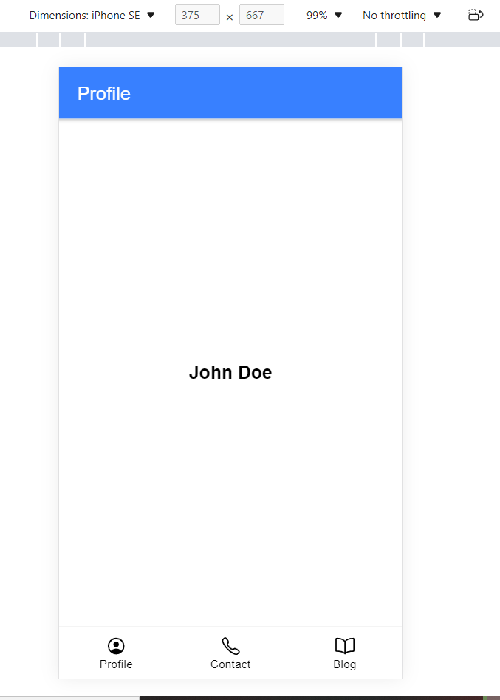
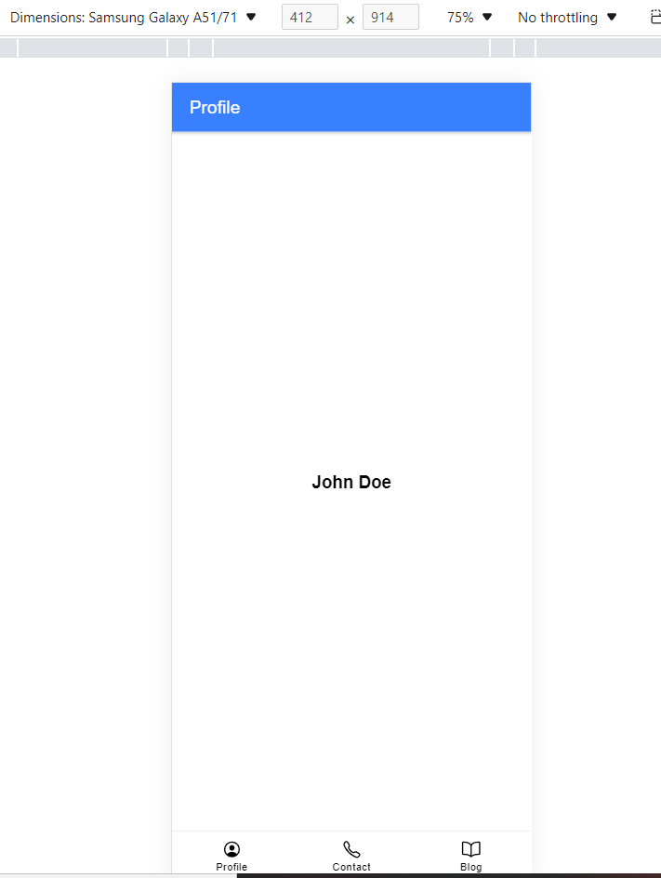
Tabs App structure

